Slide 1


Logic Circuits Exercise 3
Horvath David-Cristian
Group 913

Slide 2

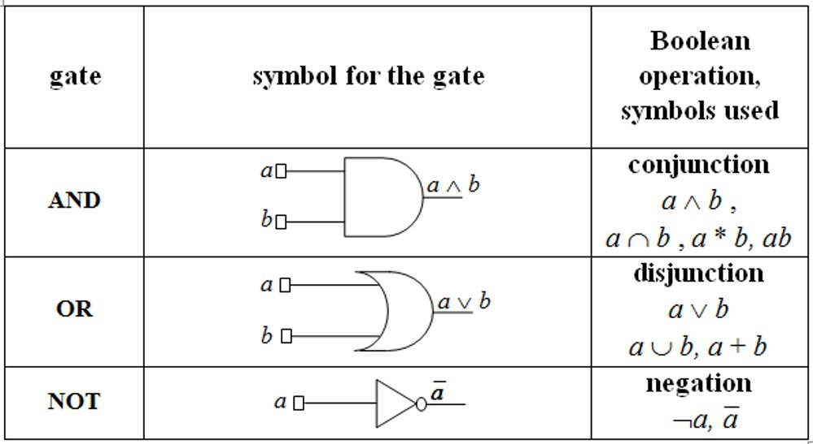
Theory – Basic Gates

Slide 3
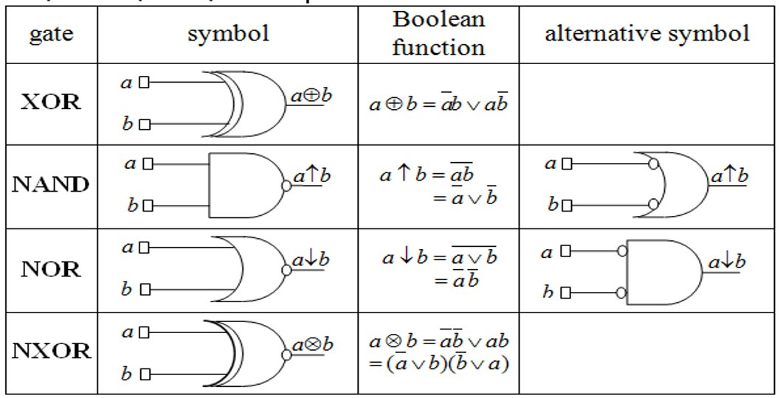
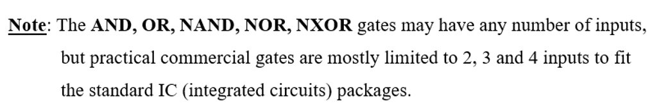
Theory – Derived Gates

Slide 4

Problem Statement
Exercise 3.
Draw a logic circuit having 3 input wires and containing all basic and derived gates. Write the corresponding Boolean function, simplify it and then draw a simplified circuit equivalent to the initial one.

Slide 5
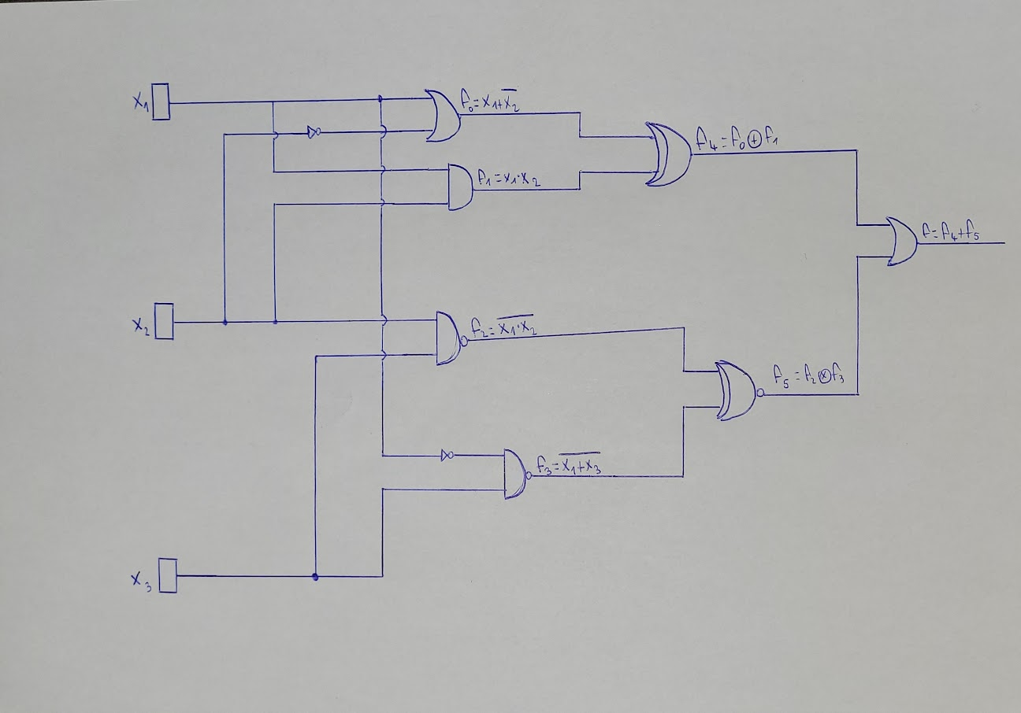

Slide 8
